Slide 1
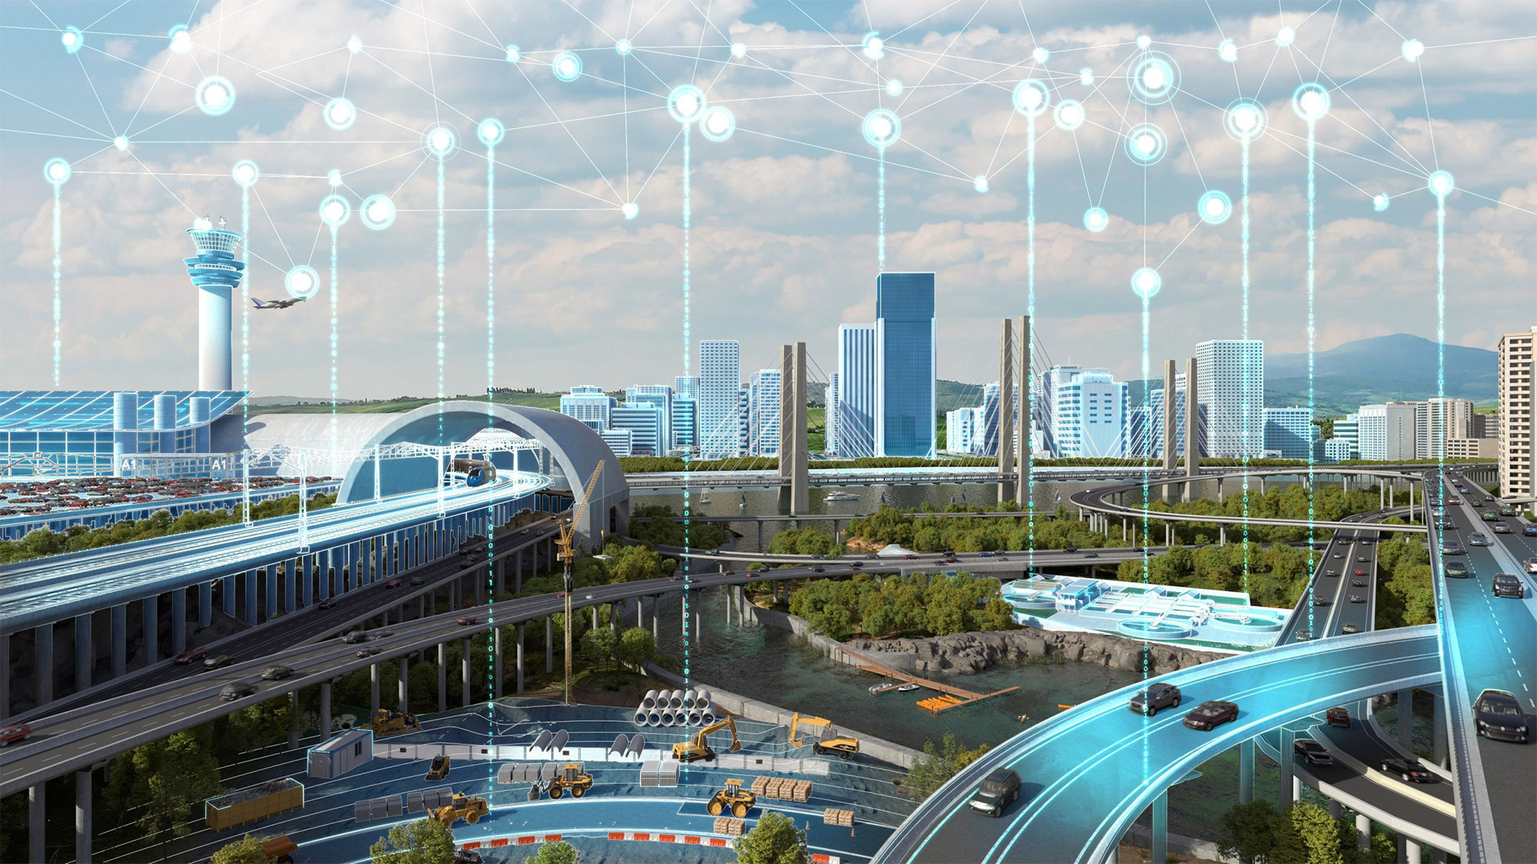
From 2D to 3D:
Innovative Digital Reconstruction
in Civil Infrastructure
Yingxue Zhang
28/03/2024
Notes:
topic

Slide 2
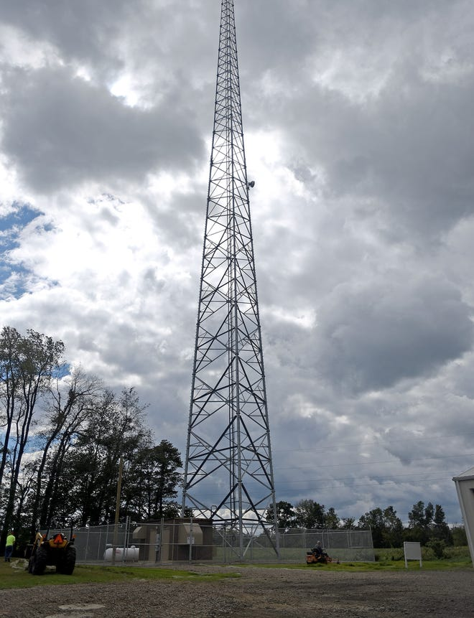
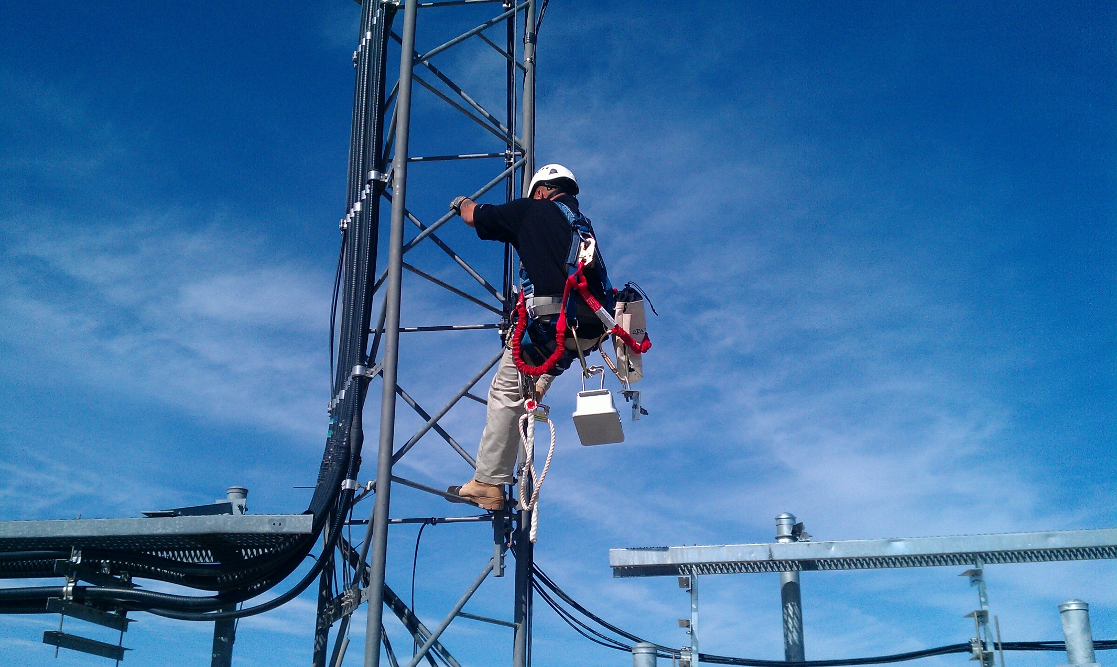

Motivation
Routine inspection of a wireless tower
Look for rust, and cracks; or confirm if communication equipment (including transmitters, receivers, and antennas) is still in the correct location.
Imagine a scenario:
Notes:
As you know, wireless towers provide a variety of wireless communication services, and our modern life is inseparable from them. Let’s imagine a scenario: Routine inspection of a wireless tower…….
This kind of high-altitude work is very dangerous, and the Labor costs are high. So How to mitigate this problem?
So I think It would be great if we could see the current status of the wireless tower remotely without having to physically climb it.
This is my motivation for researching 3D reconstruction technologies.

Slide 3
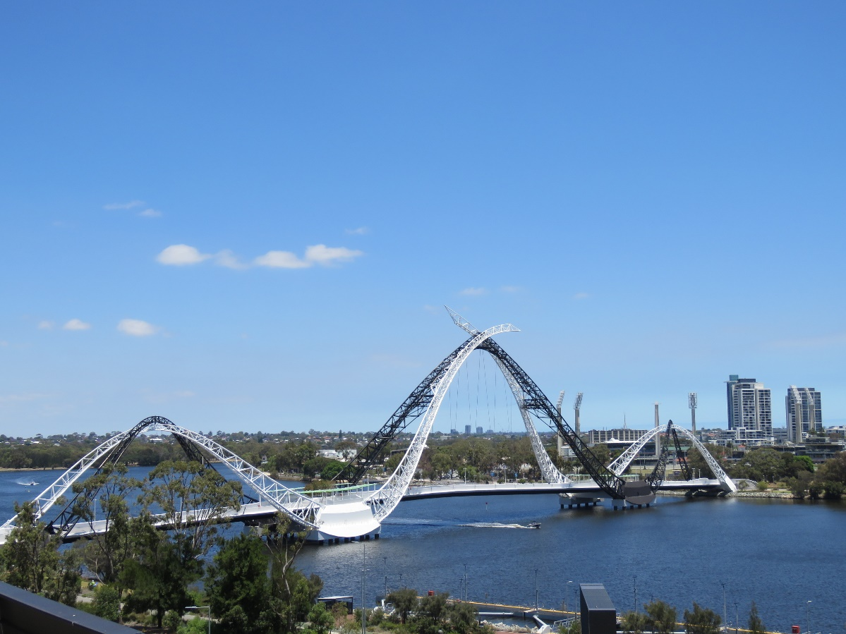
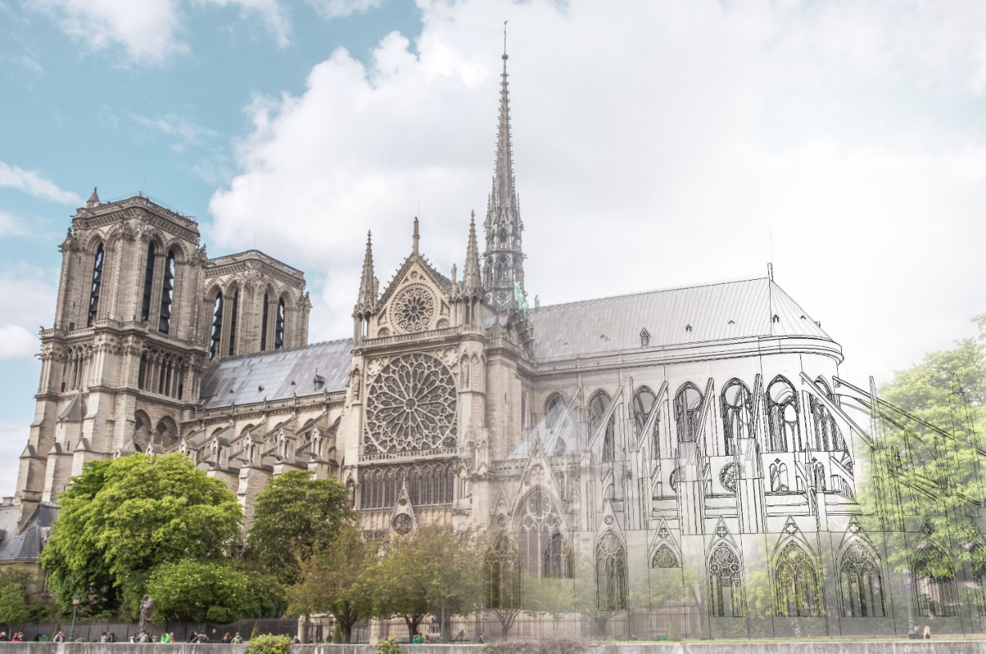

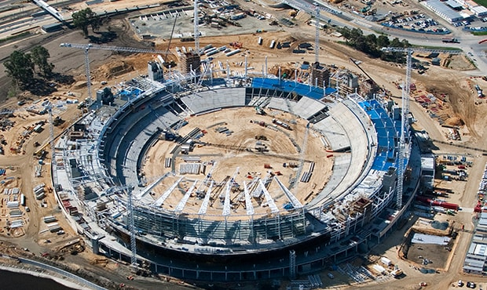
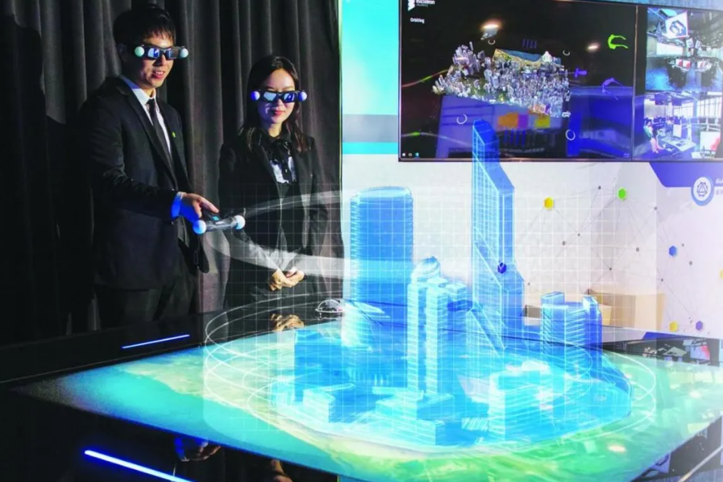
Operation stage:
Design stage:
Importance
3D Reconstruction in Civil Infrastructure
Routine inspection of a bridge
Renovation design
Construction stage:
Others:
It is meaningful for the whole life cycle of the building or infrastructure.
Monitor construction progress remotely
Discuss and solve problems intuitively
Notes:
The importance of 3D Reconstruction in Civil Infrastructure is very large, as I talked about in week 3. It is meaningful for the whole life cycle of the building. Such as Design stage, Construction stage and Operation stage.

Slide 4
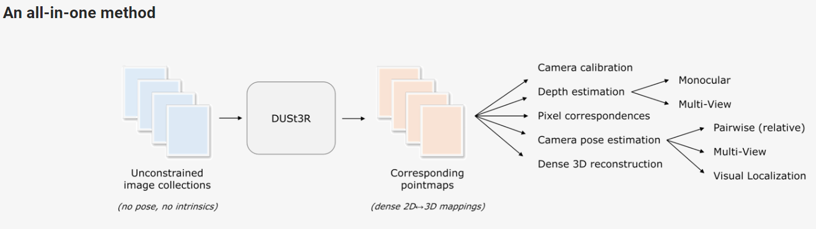
Approach
DUSt3R —— A radically novel paradigm for Dense and Unconstrained Stereo 3D Reconstruction.
Only needs arbitrary image collections!
It gets rid of two tedious key steps in all Multi-view stereo reconstruction(MVS) algorithms for the best performance.
Estimate the camera parameters
Triangulate corresponding pixels in 3D space (including camera calibration and viewpoint poses)
Notes:
The approach of this research is DUSt3R. It is ……As shown in this figure, it is an all-in-one method. The most important thing is that it gets rid of ……Now they are not needed.

Slide 5
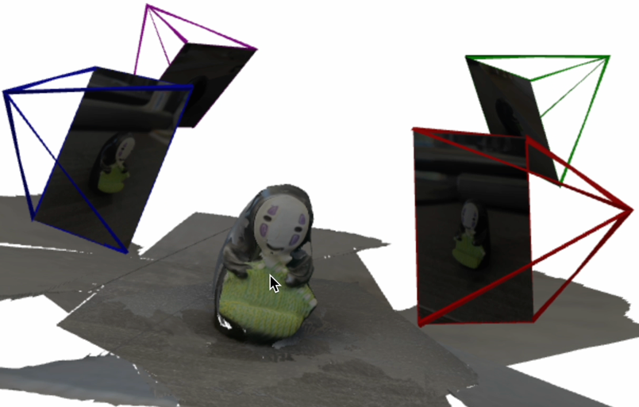
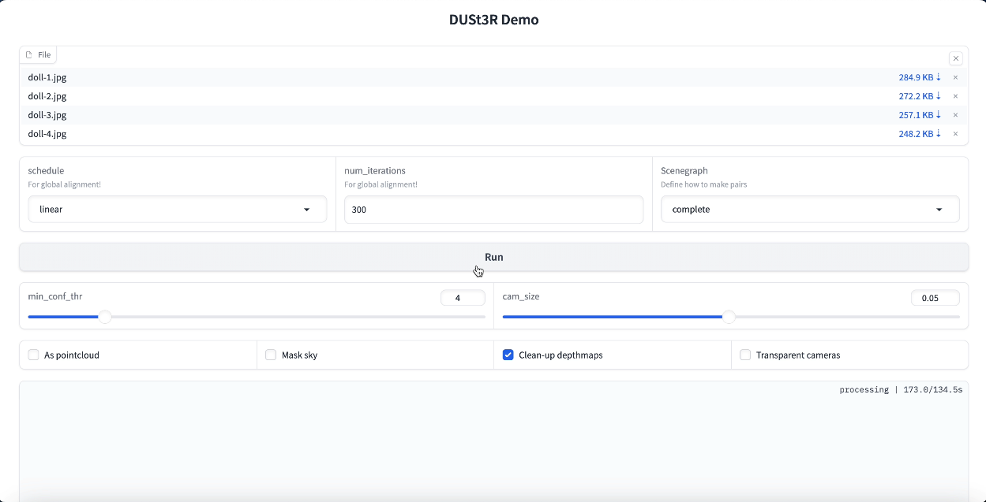
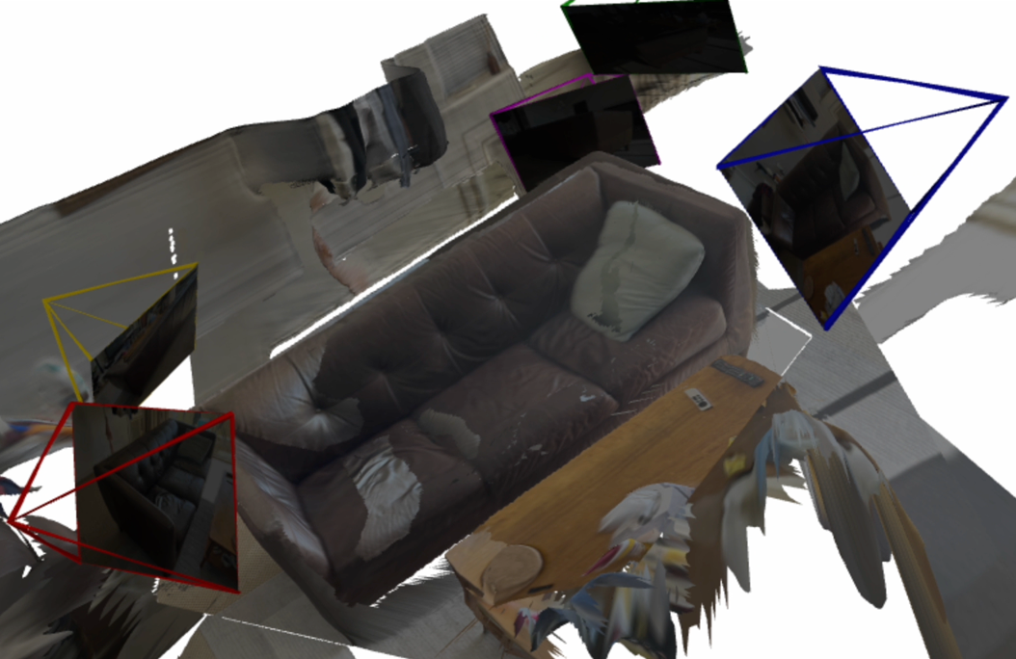
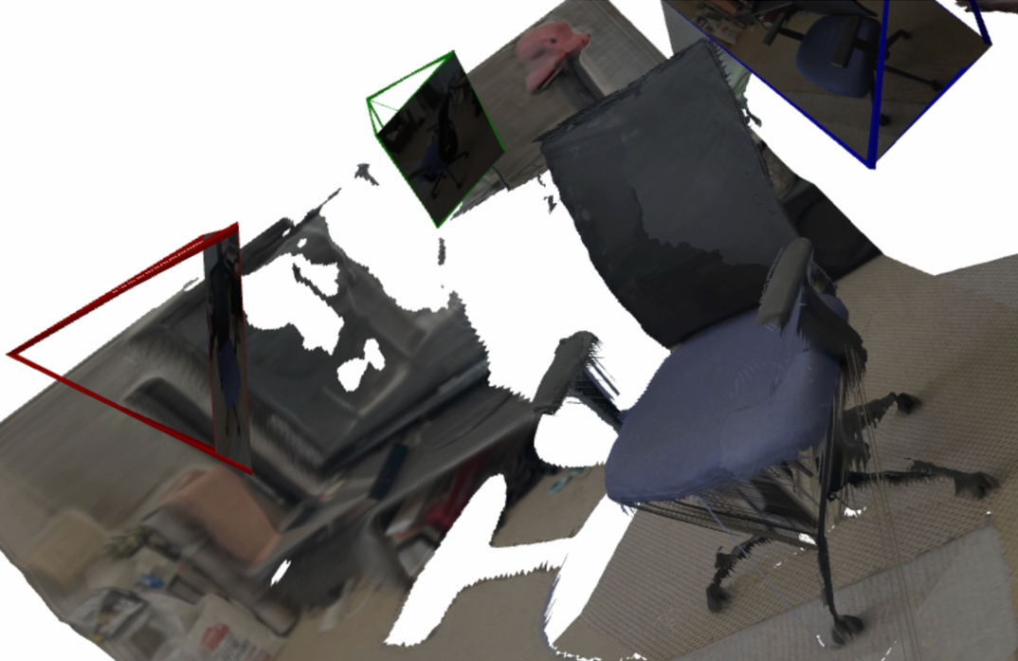
Approach
Run DUSt3R
UI
Here are some of my tests…
Need Optimization
Notes:
When the code of DUSt3R is executed, a user interface will appear that allows me to upload images and create a 3D model. The output format is .glb.
But as you know, Each method has its drawbacks, so an optimized method for civil infrastructure based on it needs to be proposed.
(Performance, the completeness of 3D model……)

Slide 6
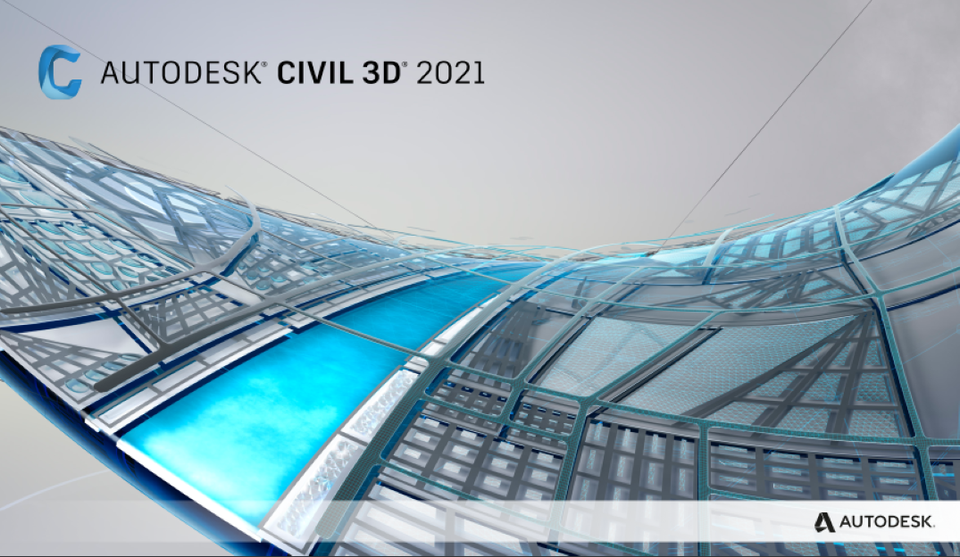
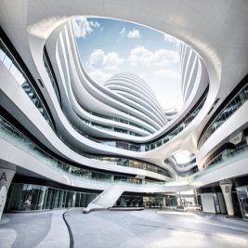
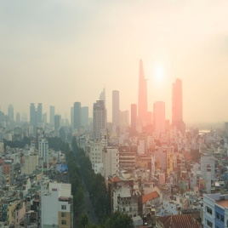
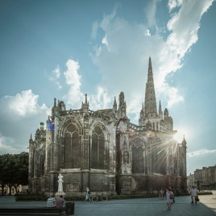
Objective
01
02
03
Comprehensively understand the current status of 3D reconstruction technology;
Find out the feasible path for algorithm optimization.
Perform 3D reconstruction of civil infrastructure；
Output relevant results.
Algorithm optimization based on DUST3R;
Applied the optimized algorithm to civil infrastructure.
Research Proposal
(this semester )
Implementation
New Idea
Notes:
The objectives of this research can be divided into 3 parts. In the 1st part, I need to……In the 2nd part, I’ll……In the last part, I’ll do the……
The objectives in the 1st part are the goals for this semester, and the research proposal will be done.

Slide 7
Research Plan
Timeline of Term 1
Task/Activity | 2024
 | Mar | Apr | May | Jun | Jul
Literature review and taking notes of core materials
Research question refine
Research proposal writing
Preliminary results collation
Any risk assessment, ethics, approvals etc.

Slide 8
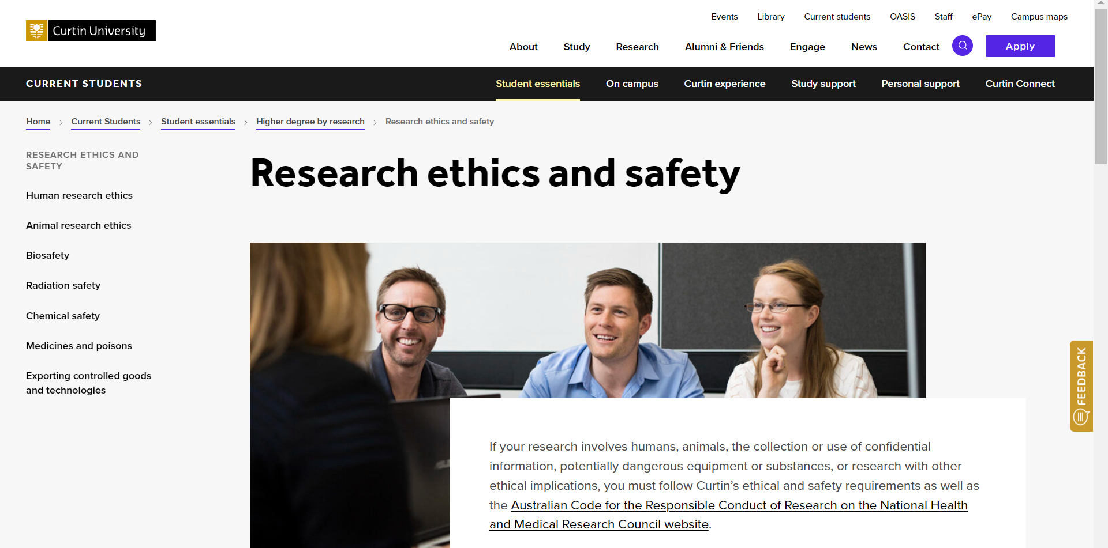
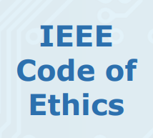

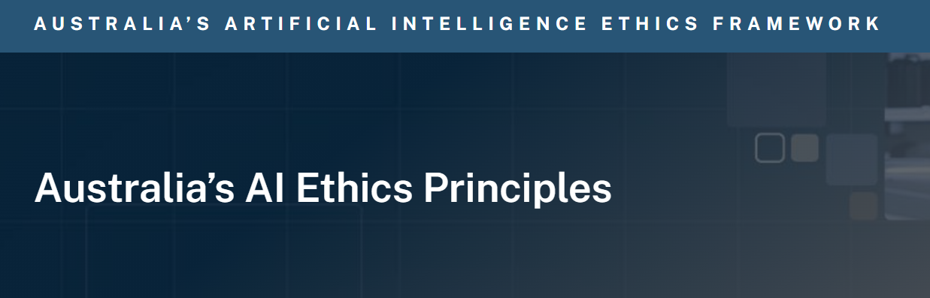
Ethics
Data collection: All data are legally obtained from public data.
Ensure
Ensure that the obtained data does not contain sensitive or personal information.
Confirm
Confirm that the data use license permits the research to be done and that any output complies with copyright and usage conditions.
Evaluate
Evaluate that the obtained data is not misused or misrepresented.
This research does not involve humans, animals, the collection or use of confidential information, potentially dangerous equipment or substances, or other ethical implications.
Notes:
About Ethics. This research obeys ethical principles about computing in Australia.

Slide 9
Research Team
Pro. Li
Dr. An
Yingxue
Research
Notes:
Now let me introduce my research team. Besides me, the research is supervised under Pro. Li and Dr. An. They help me a lot and continue to provide support in the follow-up.

Slide 10
Thanks
Notes:
That’s all my presentation. Thanks for listening.

